Slide 1
Battle of the Neighborhoods New York City vs. Toronto
Lian Wang
August, 2020

Slide 2
Relocating: New York City ⬄ Toronto
The old way
Facing unknown, anxiety
Limited information and resource, trial and error
Hassle of multiple moving
What could be better?
“Learn” about the neighborhoods in the new city in advance
Compare the neighborhoods in the two cities
Recommend/pick target neighborhoods based on knowledge of the old city
Location data and machine learning could help

Slide 3
Data Sources
New York City neighborhood data with geographical details
At https://cocl.us/new_york_dataset from this course
Toronto neighborhood data with geographical details
From Wikipedia page at https://en.wikipedia.org/wiki/List_of_postal_codes_of_Canada:_M
At http://cocl.us/Geospatial_data from this course
Foursquare API to extract neighborhood venues details within 500 meters of radius, limit up to 100 retrieves.

Slide 4
Data Summary
409 neighborhoods
306 in New York City
103 in Toronto
458 unique venue categories from Foursquare
Neighborhood summary measures
Number of venue counts – how busy
Number of unique venue category counts – how diverse/convenient
Clustering analysis features
Number of venues in each unique venue category in each neighborhood

Slide 5
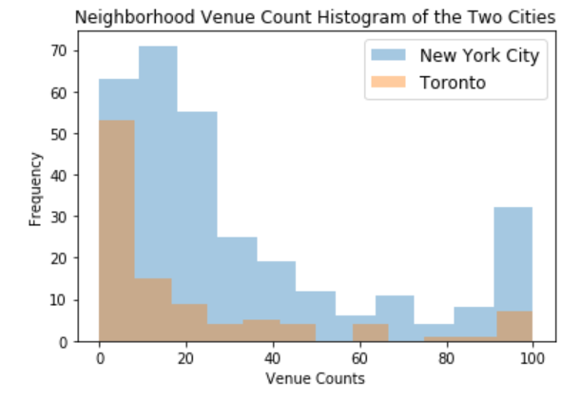
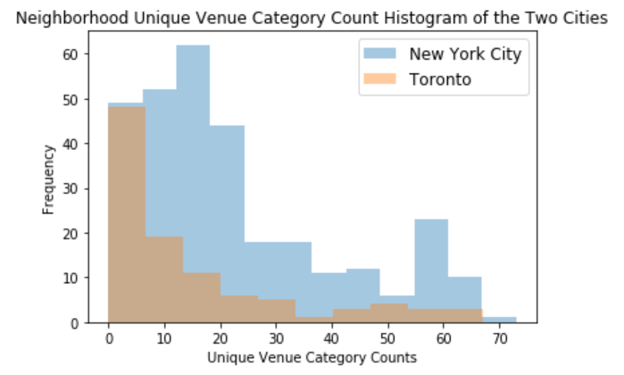
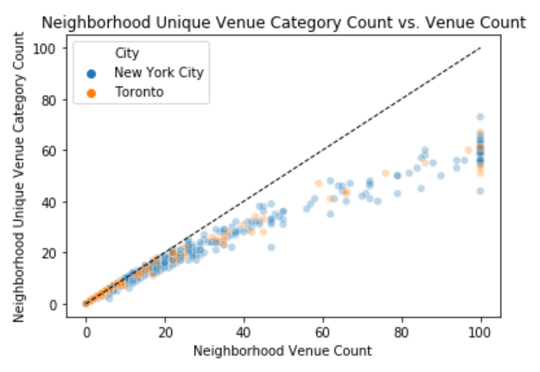
Overall, different yet similar…
New York City has more neighborhoods than Toronto across the whole spectrum of venue counts or unique venue category counts, no surprise since it has about 3 times more neighborhoods
Similar histogram patterns follow a somewhat lopsided U-shape for both cities
The neighborhoods from the two cities are relatively well mixed across the whole spectrum of these two measures in the scatter plot

Slide 6
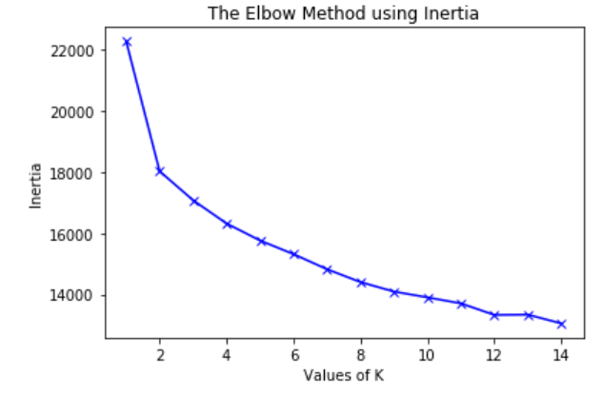
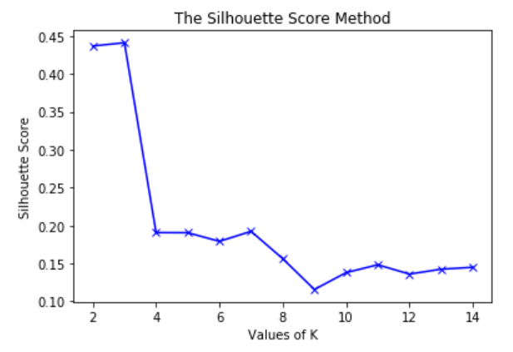
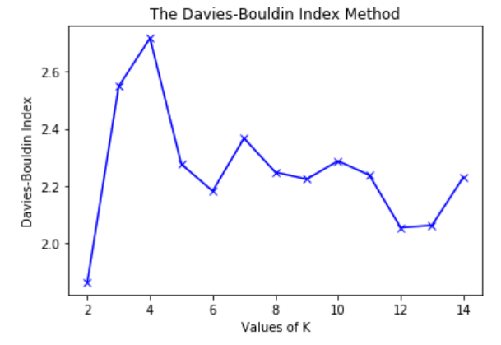
How many clusters to use for K-means?
Elbow-method not clear, could do 3-6
Silhouette-method suggests 3
Davies-Bouldin Index suggests 4
Decide on 4 (3 resulted in very uneven clusters, 5-6 resulted in one very small cluster of 2 neighborhoods)

Slide 7
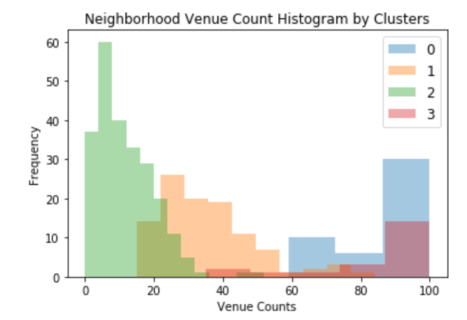
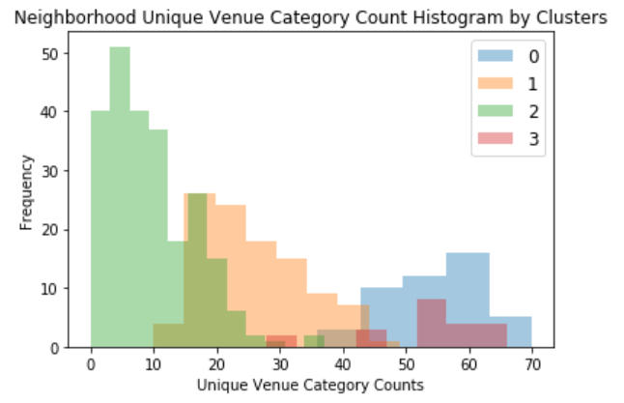
Meet the Four Clusters
Cluster 0: Most with high venue counts (>60) and high unique venue category counts (>40)
Cluster 1: Most with medium venue counts (20-60) and medium unique venue category counts (20-40)
Cluster 2: Most with low venue counts (<20) and low unique venue category counts (<20)
Cluster 3: Most with high venue counts (>60) and high unique venue category counts (>40)
* Can’t tell what is different between cluster 0 and 3, both being the high venue count/high unique venue category count type using these two measures only.

Slide 8
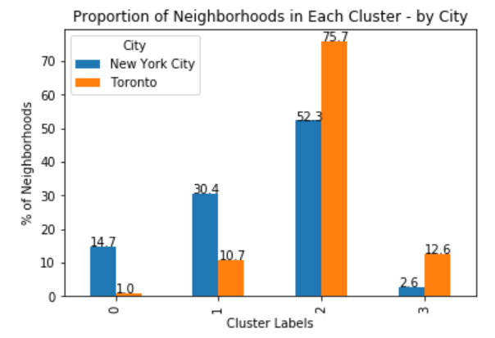
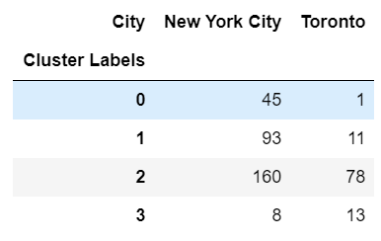
Compare Clusters by City
Chi-squared test based on the table indicates shows difference in the neighborhood cluster distribution between the two cities (p<0.001)
Toronto
Higher proportion of neighborhoods in cluster 2 (the low venue counts/low unique venue category count cluster)
Lower proportion of neighborhoods in cluster 1 (the medium venue counts/medium unique venue category counts cluster)
Cluster 0, almost exclusive to New York City neighborhoods
Both cities have at least one neighborhood in each cluster

Slide 9
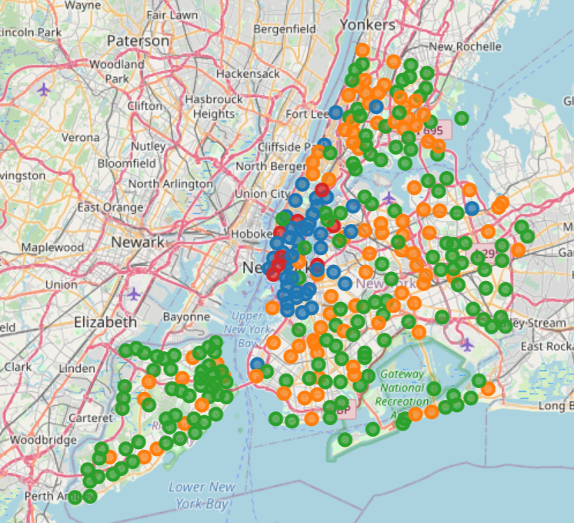
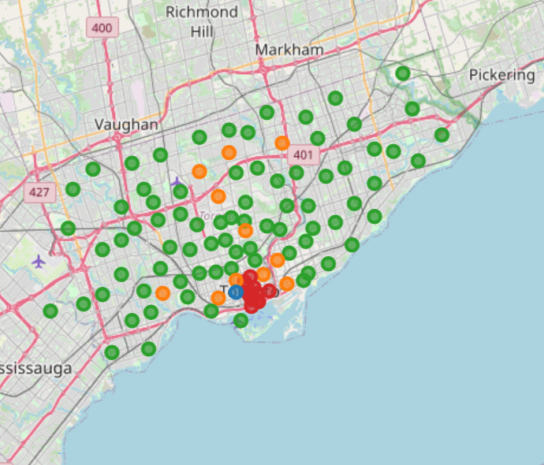
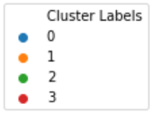
Map view
Toronto
New York City
New York City, more neighborhoods and more densely packed
Similar cluster distribution patterns
High venue count/unique venue category count (Clusters 0 and 3, blue and red) are aggregated around city center (Manhattan for NYC, Downtown Toronto for Toronto)
Others spread out and farther from the center

Slide 10
Recommending target neighborhoods
When target cluster in a city has 5-10 neighborhoods, recommend those
When target cluster in a city has <5 neighborhoods, expand the target to clusters that are most close to the initial target cluster
When target cluster in a city has >10 neighborhoods
Slightly >10, use further restrictions to narrow down the target, say, must contain work-out venues or other criteria
>>10, repeat the clustering analysis using the target cluster neighborhoods in both cities
Could use different features (say, top 100 most retrieved venue categories only, or a prespecified focus category set).
Iterate if needed until the final target cluster contains 5-10 neighborhoods

Slide 11
Summary
New York City and Toronto are different
Number of neighborhoods (NYC has more)
Density of neighborhoods (NYC neighborhoods are more packed)
Cluster distribution (Toronto has higher proportion of low venue count/unique venue category count)
One high venue count/unique venue category count cluster contains almost exclusively NYC neighborhoods
Yet, their neighborhoods are similar
Venue count and unique venue category count distribution patterns somewhat lopsided U-shape for both cities
Cluster distributions on the map show similar pattern as well
Most importantly, both cities have at least one neighborhood in every cluster, meaning one could always find similar neighborhoods base on their ideal neighborhood in the old city and feel welcome and comfortable relocating!

Slide 12
Future Work
Other unsupervised machine learning techniques could be used other than k-means
Features could be retrieved and extracted differently from locational data
Other data sources could be incorporated
More user input could be added as restrictions or guide the feature formulation
With the larger amount of diverse data and the power of machine learning, relocating across the global could be a better and easier experience…

